Slide 1
Web-Property Property-Hub
Project Presentation
Team Name:
PROPERTY CRAFTERS
Team members:
Walid Abdullahi (Leader), Stuart Idehen

Slide 2
Team Information
Team Members and Roles:
Walid Abdullahi:
Responsible for implementing design and structure of the project.
Led the project and implemented critical features including user registration, login and database connectivity.
Develop the backend logic for securely storing user data and validate credentials and property management tools with advanced search functionality.
Stuart Idehen:
Developed the UI layout and Testing.
Style and refine property cards dashboards and general UI while ensuring responsive design for mobile and desktop compatibility.
Test backend workflows (registration, login, and database queries) and perform security checks for form handling and database integration.

Slide 3
Problem Statement & Objectives
Problem Statement:
The real estate industry faces challenges in connecting buyers, sellers, and administrators due to fragmented platforms and inefficient property management tools. There is a need for a unified, secure, and user-friendly platform that streamlines property transactions. With our project Web-Property, we aim to create a platform connecting property buyers and sellers in a seamless manner.
Objectives:
User-Centric Dashboards: Develop tailored dashboards for buyers, sellers, and administrators, each offering intuitive tools for property search, management, and platform oversight.
Core Functionalities: Implement secure user registration, property listing and management, advanced search, and filtering tools to ensure efficient transactions.
Responsive and Secure Design: Create a responsive UI with intuitive navigation and implement security measures for data handling and form submissions.

Slide 4
Project Overview
Property-Hub | Web Property :
Property-Hub is a web platform designed to seamlessly connect property buyers and sellers while offering robust management tools for administrators. It features three dedicated portals: Buyer Dashboard, Seller Dashboard, and Admin Dashboard – each tailored to specific user needs.
Key functionalities include secure user registration and login, property listing and management, advanced search and filtering, and business analytics.
The platform prioritizes responsive design, intuitive navigation, and secure data handling with database integration.
The platform aims to create an efficient and intuitive space for property transactions, empowering users with the tools they need to manage, search, and analyze real estate data effectively.

Slide 5
KEY FEATURES (A) :
Role-Based Dashboards:
Buyers can search and filter property listings and manage a wishlist.
Sellers can manage property listings with options to add, edit, and delete properties.
Administrators have access to analytics, user activity monitoring, and platform management tools.
User Authentication :
A secure login and registration system ensures only authorized access.
Role selection during registration directs users to the appropriate dashboard.

Slide 6
KEY FEATURES (B) :
Dynamic Property Management:
Buyers interact with dynamic property cards showcasing property details.
Sellers utilize tools to update and monitor listings.
Responsive and Modern Design :
CSS-based styling ensures a seamless user experience across all devices.
Consistent navigation and layout enhance usability.

Slide 7
Architecture and Design (a)
Architecture and Design:
admin.html: Provides the Admin Dashboard interface with analytics and tools for monitoring platform performance.
buyer.html: Serves as the Buyer Dashboard, offering property search, wishlist management, and dynamic property card displays.
db_connect.php: Handles database connection logic to facilitate secure interactions between the application and the database.
index.html: Acts as the landing page, introducing the platform's features and linking to registration and login pages​.
login.html: Provides a login form for user authentication, directing users to role-specific dashboards upon successful login.
login.php: Processes user login requests by validating credentials and managing session data securely.

Slide 8
Architecture and Design (B)
Architecture and Design:
register.html: Features a user registration form with role selection, collecting details to create buyer, seller, or admin accounts.
register.php: Handles backend logic for user registration, storing user details securely in the database.
seller.html: Provides the Seller Dashboard with tools to manage property listings, including options to add, edit, and delete properties.
styles.css: Contains shared CSS styles to ensure consistent design, responsive layouts, and user-friendly navigation across the platform.

Slide 9
Scrum Method in Project Management
The Property-Hub project was divided into sprints and tasks in order to distribute and manage responsibilities between two team members effectively.
How we applied SCRUM: Daily Stand-ups: 15-minutes to discuss tasks completed thus far and future To-Do activities.
Sprint 1: Foundation Setup
Objective: Functional user registration and login system, laying the foundation for role-based dashboards.
Member A: Create register.html and login.html pages with user-friendly forms for data input​. Ensure proper styling and responsive design for these pages using styles.css.
Member B: Develop the admin.html dashboard to display platform analytics and user activity. Create backend logic to populate dashboards dynamically (e.g., load properties).
Sprint 2: Dashboard Implementation
Objective: Completed dashboards tailored to user roles, integrated with the database for dynamic content.
Member A: Design buyer.html and seller.html dashboards, adding sections for search, property management, and wishlist functionality. Refine UI elements using styles.css to ensure consistency and responsiveness​.
Member B: Develop the admin.html dashboard to display platform analytics and user activity. Create backend logic to populate dashboards dynamically.
Sprint 3: Advanced Features and Finalization
Objective: A fully functional, secure, and polished platform ready for deployment.
Member A: Refine the design of property cards in buyer.html and seller.html to display property details dynamically. Test and optimize the platform for responsive design and cross-browser compatibility.
Member B: Develop backend logic for property search functionality and seller property management tools (add, edit, delete). Conduct security testing to ensure secure form handling and database interactions.

Slide 10
SCRUM METHOD BENEFITS
SCRUM Benefits in our Project:
Task Prioritization:
Sprints ensured key features (e.g., user authentication) were prioritized.
Collaboration:
Clear division of tasks allowed both team members to work efficiently and independently.
Future Benefits of SCRUM:
SCRUM’s iterative framework ensures scalability and adaptability as the platform evolves.
Task prioritization based on user value ensures delivery of impactful features in future projects.
Retrospectives foster continuous improvement and address challenges effectively.

Slide 11
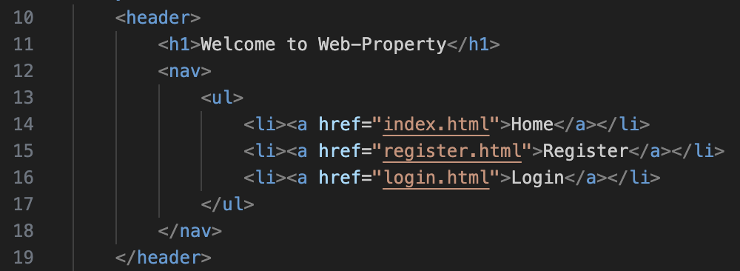
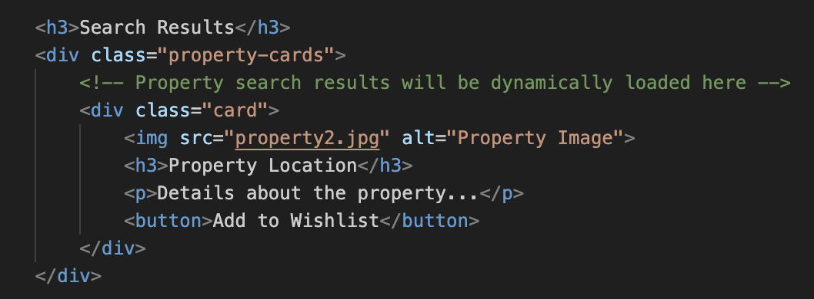
Technical Implementation: Navigation & Effective styling
Code (index.html):
Code (buyer.html):
The navigation bar is consistently applied across all pages, creating familiarity and ease of access for users.
Each link is descriptive (e.g., "Register"), guiding users to specific functionalities without confusion.
Simple <ul> and <li> elements maintain a clean structure, and additional styling in styles.css enhances usability across devices
The consistent use of headers (<h3>) and styled paragraphs ensures readability and structured content..
The button provides clear call-to-action functionality, enhancing user interactivity.
Images with descriptive <alt> attributes improve accessibility and visually enrich the property display.

Slide 12
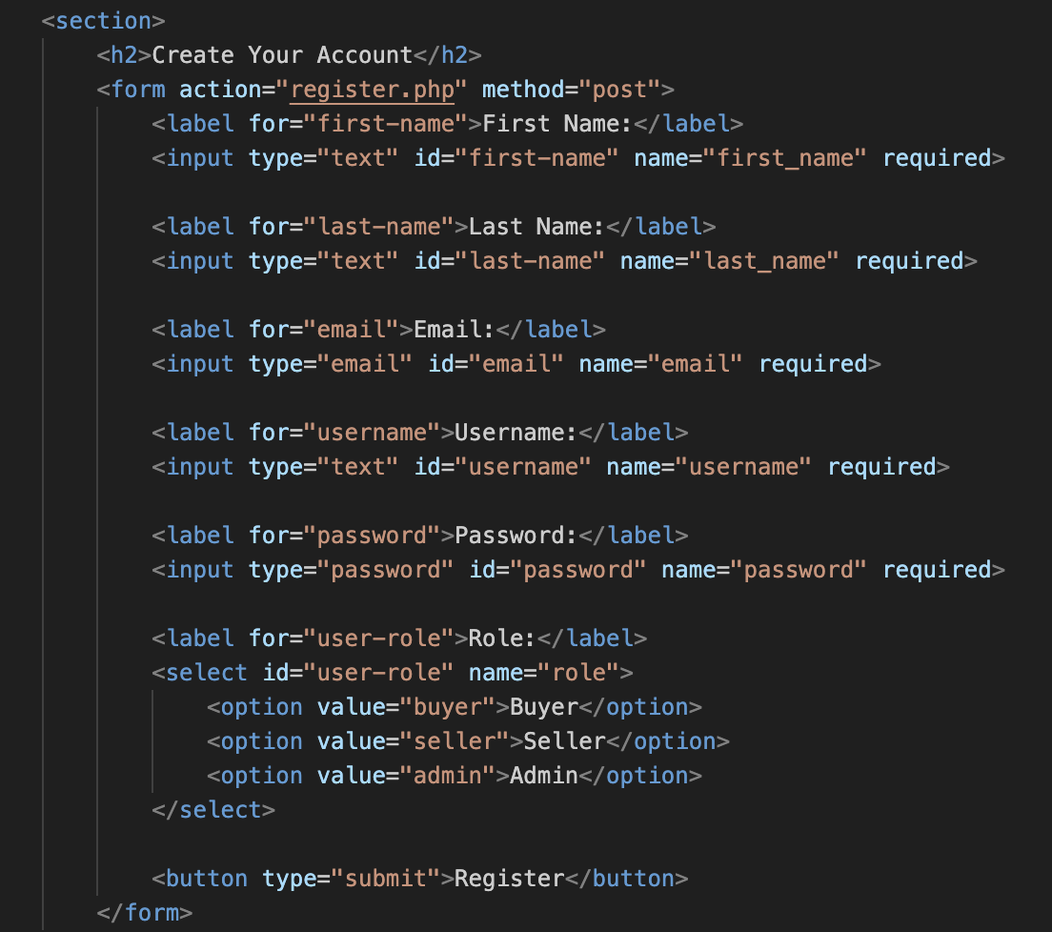
Technical Implementation: form processing
Code (register.html):
The form uses semantic elements like <label> and type="email" for accessibility and ensuring proper data validation.
The action="register.php" attribute securely sends user input to the backend, separating processing logic from the UI.
Required fields (required attribute) enforce input validation at the browser level, reducing server load​.

Slide 13
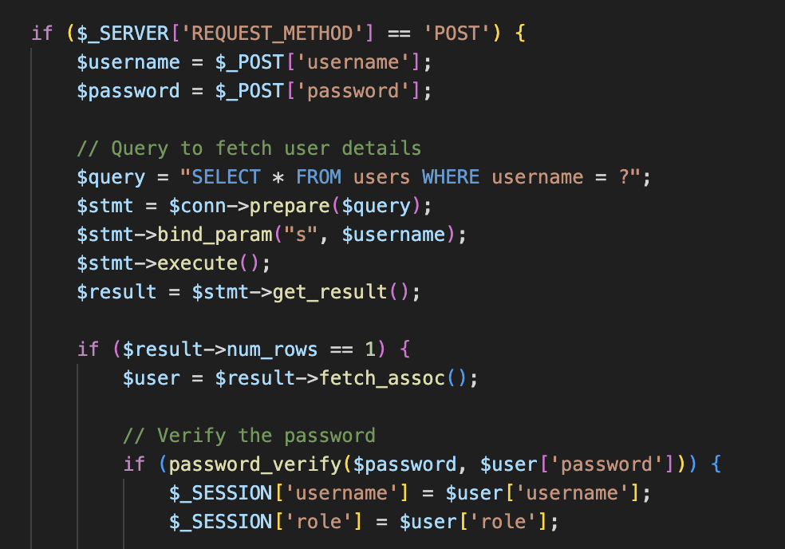
Technical Implementation: login--for registration & users
Code (login.php):
Form Processing: Captures username and password from a POST request and ensures secure input handling.
User Validation: Uses a prepared statement to query the database for the username, preventing SQL injection.
Authentication and Sessions: Verifies the password securely with password_verify() and initializes session variables ($_SESSION['username'], $_SESSION['role']) for user access.

Slide 14
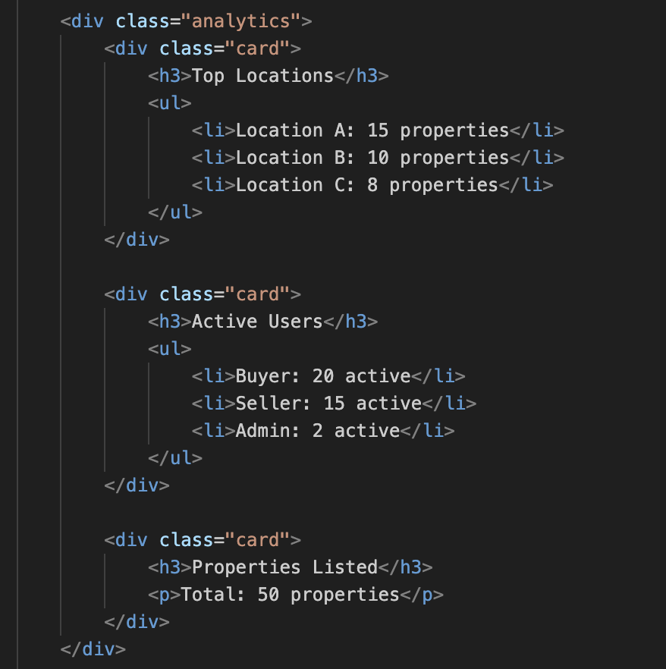
Technical Implementation: logic used (Implementation)
Code (admin.html):
Hierarchical Structure:
Uses <h3> headings and <ul> lists to organize and display data, ensuring a logical flow of information for administrators.
Logical Grouping:
The snippet logically categorizes data into sections to present insights clearly and efficiently.
Actionable Insights:
Provides administrators with key metrics (e.g., property distribution, user activity) to support platform performance analysis and decision-making.

Slide 15
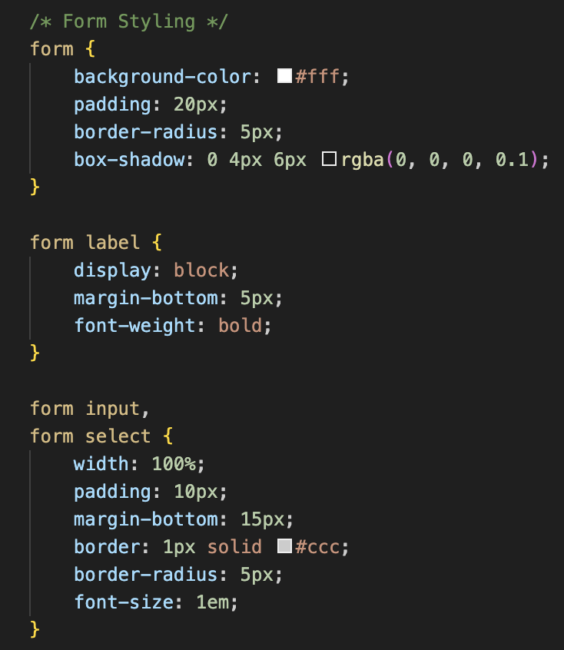
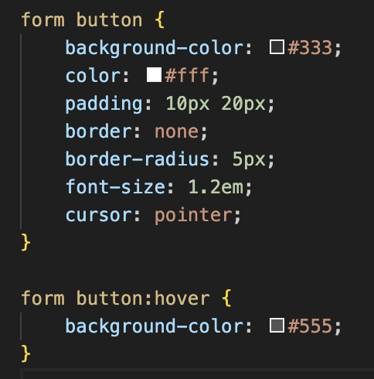
Technical Implementation: application of design principles
Code (styles.css):
The use of a shadow (box-shadow) and rounded corners (border-radius) creates a modern, visually appealing design for forms.
Clear spacing and bold labels improve readability, while full-width input fields enhance usability.
Hover effects and button styling provide visual feedback, improving the user experience​.

Slide 16
Technical Implementation: Testing
Testing Scenarios and Expected Outcomes:
User Registration
Scenario: Submit valid inputs (e.g., valid email, complete fields).
Expected Outcome: Registration succeeds, data is securely stored in MongoDB, and passwords are hashed – PASSED.
Login Redirection
Scenario: Enter valid credentials for different roles (buyer, seller, admin).
Expected Outcome: Users are redirected to their respective dashboards based on their roles – PASSED.
Property Management
Scenario: Add, update, or delete a property listing through the seller dashboard.
Expected Outcome: MongoDB reflects the changes, and updated listings are displayed dynamically – PASSED.
Search Functionality
Scenario: Apply filters (e.g., location or price range) during property search.
Expected Outcome: Search results update dynamically to match the applied filters – PASSED.
Dashboard Insights
Scenario: View user and property counts on the admin dashboard.
Expected Outcome: Counts accurately reflect the MongoDB data – PASSED.

Slide 17
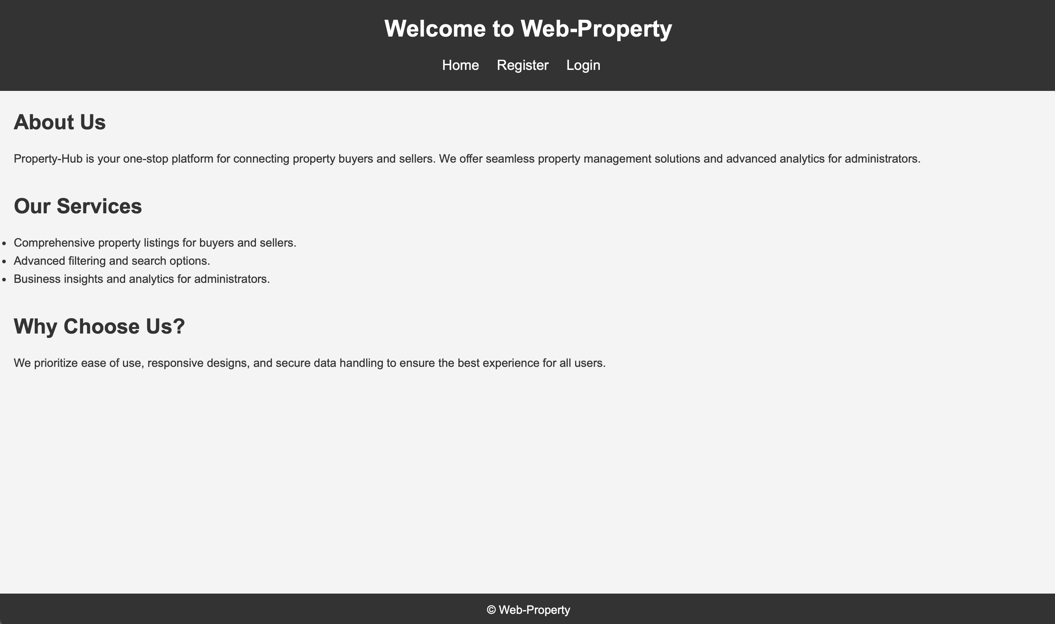
DEMONSTRATION

Slide 18


Thank you!

